Slide 1
Software Engineering
NITHYA E

Slide 2
Unit I
Introduction
Software Engineering
Product and Process
Process models
Waterfall life cycle model
Spiral model
Prototype Model
Fourth Gen technique
Agile methods

Slide 3
Software Engineering
Software
Engineering
Software engineering
is an engineering branch associated with development of software product using well-defined scientific principles, methods and procedures. The outcome of software engineering is an efficient and reliable software product.
on the other hand, is all about developing products, using well defined, scientific principles and methods.
is more than just a program code. A program is an executable code, which serves some computational purpose.
Software is collection of executable programming code, associated libraries and documentation.
Software, when made for a specific requirement is called software product.

Slide 4
Software Engineering
IEEE defines software engineering as:
The application of a systematic, disciplined, quantifiable approach to the development, operation, and maintenance of software; that is, the application of engineering to software.
Fritz Bauer, a German computer scientist, defines software engineering as:
“Software engineering is the establishment and use of sound engineering principles in order to obtain economically software that is reliable and work efficiently on real machines.”

Slide 5
Why Software Engineering?
The need of software engineering arises because of higher rate of change in user requirements and environment on which the software is working.
Large software
It is easier to build a wall than to a house or building, likewise, as the size of software become large engineering has to step to give it a scientific process.
Scalability
If the software process were not based on scientific and engineering concepts, it would be easier to re-create new software than to scale an existing one.
Cost
As hardware industry has shown its skills and huge manufacturing has lower down the price of computer and electronic hardware. But the cost of software remains high if proper process is not adapted.
Dynamic Nature
The always growing and adapting nature of software hugely depends upon the environment in which the user works. If the nature of software is always changing, new enhancements need to be done in the existing one. This is where software engineering plays a good role.
Quality Management
Better process of software development provides better and quality software product.

Slide 6
Characteristics of good software A software product can be judged by what it offers and how well it can be used. This software must satisfy on the following grounds:
Operational :
This tells us how well software works in operations.
Transitional:
This aspect is important when the software is moved from one platform to another .
Maintenance:
This aspect briefs about how well a software has the capabilities to maintain itself in the everchanging environment:

Slide 7
Operational
Budget
Usability
Efficiency
Correctness
Functionality
Dependability
Security
Safety
Transitional
Portability
Interoperability
Reusability
Adaptability
Maintenance
Modularity
Maintainability
Flexibility
Scalability

Slide 8
Product & Process
Product
The product is the final outcome of the software development process.
A product is built on the customer's requirements/requests.
Process
The process is a set of steps that are to be followed to create a product.
A process is a template that can be used to create multiple products in a similar fashion.

Slide 9
Difference b/w Product & Process The following are some of the important differences between Product and Process.
Sr. No. | Key | Product | Process
1 | Concept | The product is the final result of a development cycle. | The process is a sequence or set of steps that should be followed to create a product.
2 | Focus | Product development focus is on final outcome. | The process focuses on each step to be followed during software product development.
3 | Life | A product life cycle tends to be in the short term. | A process life cycle is generally long term.
4 | Goal | The main goal of product development is to finish the work and get the product delivered successfully. | The main goal of a process is to make a good quality products.

Slide 10
What is a software process model?
A software process model is an abstraction of the software development process. The models specify the stages and order of a process. So, think of this as a representation of the order of activities of the process and the sequence in which they are performed.
A model will define the following:
The tasks to be performed
The input and output of each task
The pre and post conditions for each task
The flow and sequence of each task.

Slide 11
Different Process models
There are many kinds of process models for meeting different requirements. We refer to these as SDLC models (Software Development Life Cycle models). The most popular and important SDLC models are as follows:
Waterfall model
V model
Incremental model
RAD model
Agile model
Iterative model
Prototype model
Spiral model

Slide 12
Important SDLC Models
Waterfall Model
Prototype
Spiral Model
Agile

Slide 13
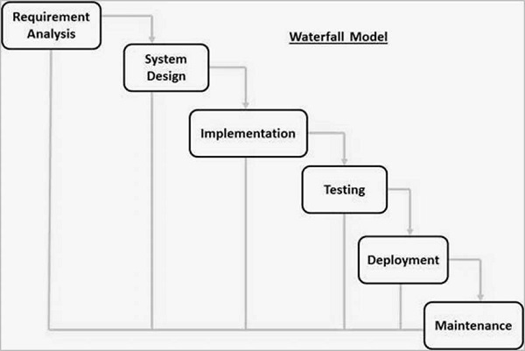
Waterfall Model
Waterfall model is the simplest model of software development paradigm. All the phases of SDLC will function one after another in linear manner. That is, when the first phase is finished then only the second phase will start and so on.

Slide 14
Waterfall Model Advantage & Disadvantage
Simple and Easy to understand
Easy to manage
Phases are processed and completed one at a time
Requirements are well understood
Clearly define the stages
High amount of risk
Poor model for large and ongoing project.
Not good for OOP.

Slide 15
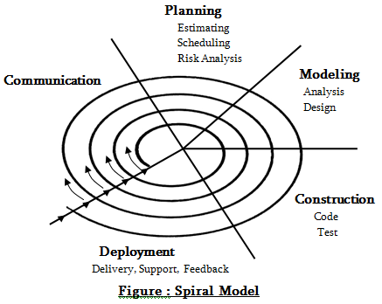
Spiral Model
The popular spiral model is a blend of both iterative development method as well as sequential improvement model, i.e., the waterfall model that is having exceptionally high importance on risk analysis. In this model, the exact number of phases for developing a product varied based on some constraints and by project manager which calculates the project risks. Here the project manager dynamically decides the number of phases and hence play a significant role in the development of a product using the spiral model. The radius in spiral usually shows the expenses or cost needed for project development. The angular dimension shows the development done to date during the recent phase.

Slide 16
When to Use Spiral Model?
When project is large.
When release are required to be frequent.
When risk and cost evaluation is important.
When requirements are unclear and complex.
When changes may require at anytime.
For medium to high risk project.

Slide 17
Advantage and Disadvantage
Additional functionality changes can be done at later stage.
Cost estimates becomes easy.
Development is fast and features are added in a systematic way.
There is always space for customer feedback.
Risk is not meeting the schedule and budget.
Documentation is more as it has intermediate phases.
It is not advisable for smaller projects, it might cost them a lot.

Slide 18
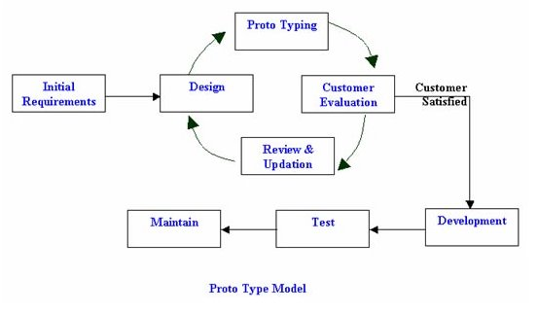
Protype Model
The prototyping model is a systems development method in which a prototype is built, tested and then reworked as necessary until an acceptable outcome is achieved from which the complete system or product can be developed.
This model works best in scenarios where not all of the project requirements are known in detail ahead of time.
It is an iterative, trial-and-error process that takes place between the developers and the users.

Slide 19
Advantage and Disadvantage
Customers can see steady progress.
This is useful when requirements are changing rapidly.
It is impossible to know how long it will take.
There is no way to know the no. of iteration will be required.

Slide 20
Fourth Generation Technique
The term fourth generation technique (4GT) encompasses a broad array of software tools that have one thing in common: each enables the software engineer to specify some characteristics of software at a high level.
The tool then automatically generates the source code based on the developer’s specification.

Slide 21
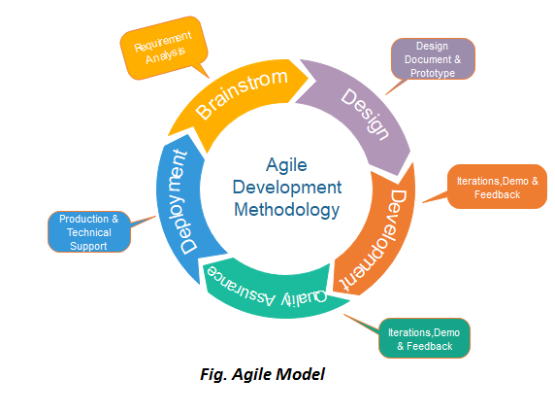
Agile

Slide 22
Agile
"Agile process model" refers to a software development approach based on iterative development.
Agile methods break tasks into smaller iterations, or parts do not directly involve long term planning.
The project scope and requirements are laid down at the beginning of the development process.
Plans regarding the number of iterations, the duration and the scope of each iteration are clearly defined in advance.
Each iteration is considered as a short time "frame" in the Agile process model, which typically lasts from one to four weeks.
The division of the entire project into smaller parts helps to minimize the project risk and to reduce the overall project delivery time requirements.
Each iteration involves a team working through a full software development life cycle including planning, requirements analysis, design, coding, and testing before a working product is demonstrated to the client.

Slide 23
Scrum
SCRUM is an agile development process focused primarily on ways to manage tasks in team-based development conditions.
There are three roles in it, and their responsibilities are:
Scrum Master: The scrum can set up the master team, arrange the meeting and remove obstacles for the process.
Product owner: The product owner makes the product backlog, prioritizes the delay and is responsible for the distribution of functionality on each repetition.
Scrum Team: The team manages its work and organizes the work to complete the sprint or cycle.

Slide 24
Advantage and Disadvantage
In Agile methodology the delivery of software is unremitting.
The customers are satisfied because after every Sprint working feature of the software is delivered to them.
Customers can have a look of the working feature which fulfilled their expectations.
If the customers has any feedback or any change in the feature then it can be accommodated in the current release of the product.
In Agile methodology the documentation is less.
Sometimes in Agile methodology the requirement is not very clear hence it’s difficult to predict the expected result.
In few of the projects at the starting of the software development life cycle it’s difficult to estimate the actual effort required.

